Slide 1


Slide 2
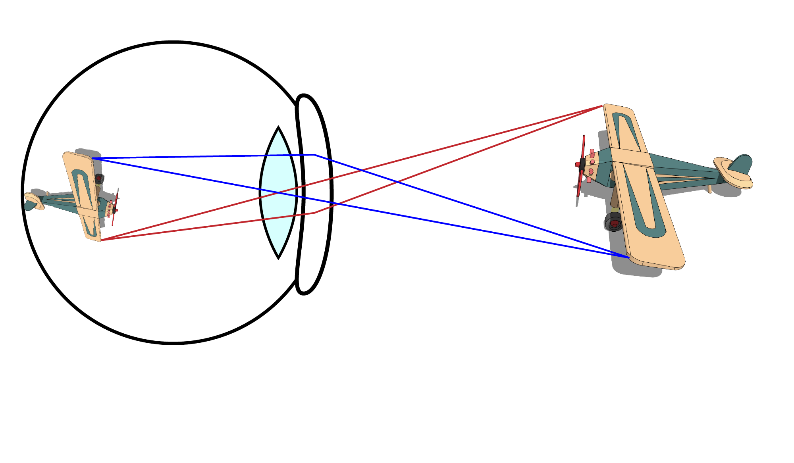
Eyes: projection onto retina

Slide 3
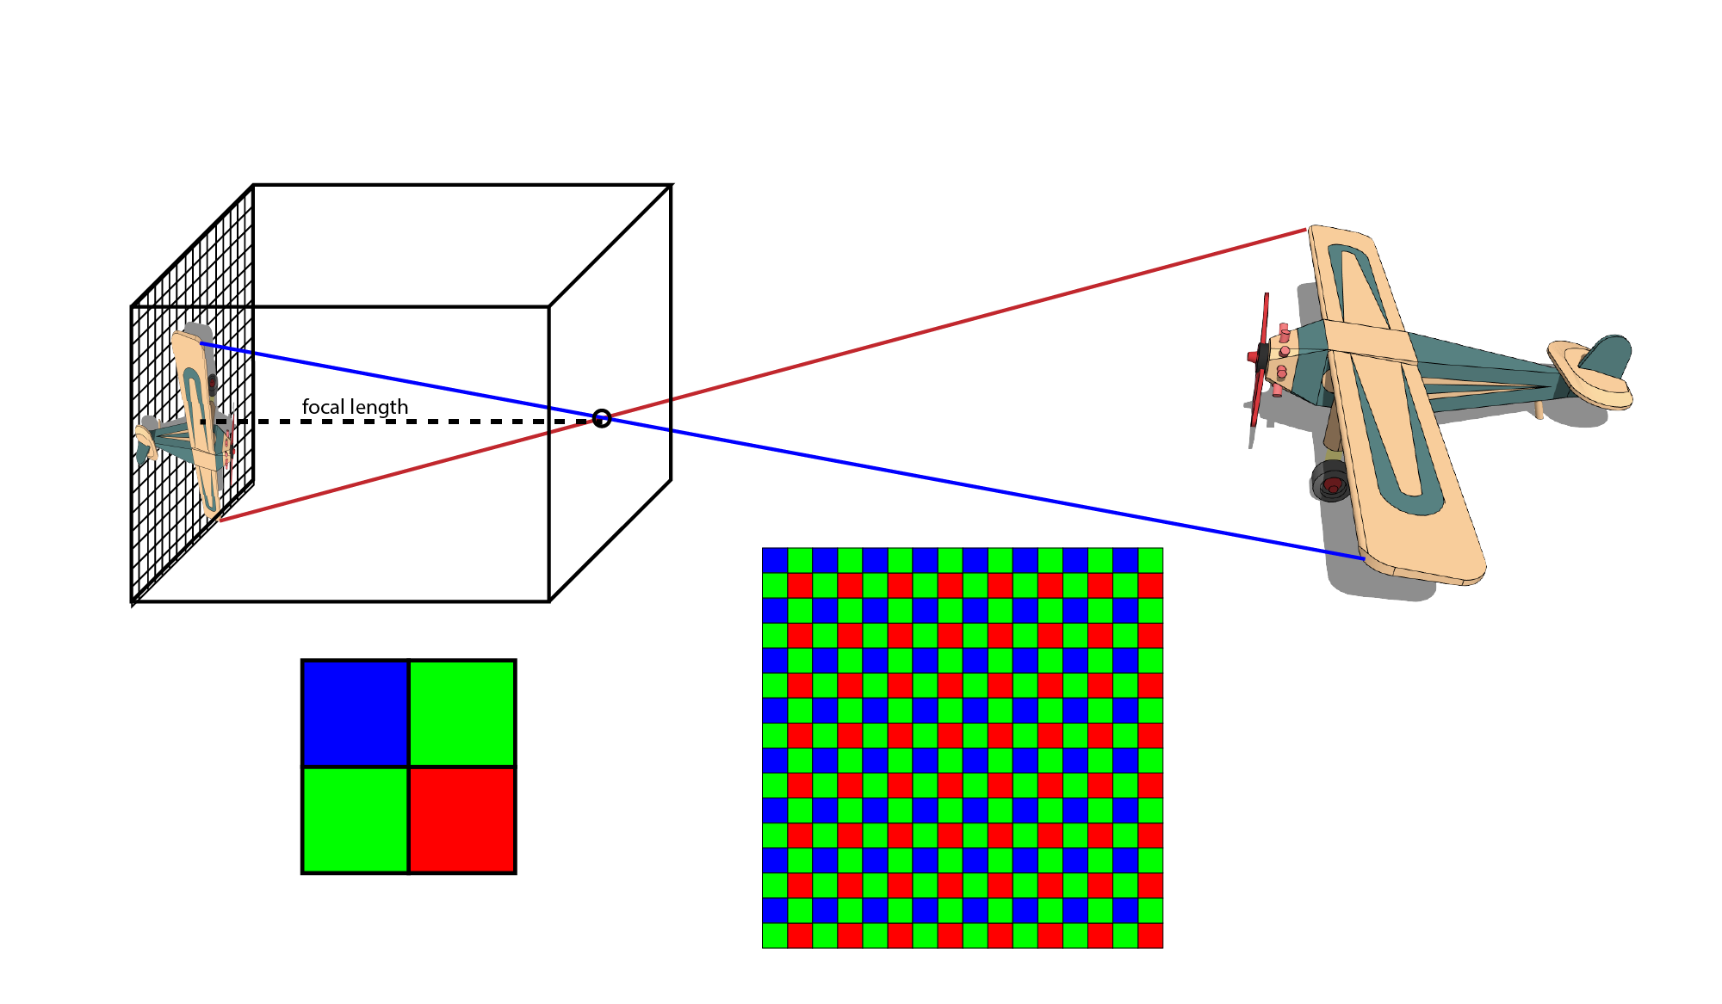
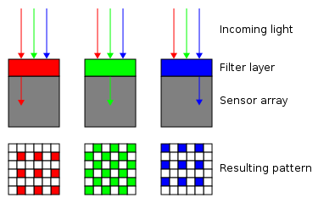
Camera: projection onto sensor array

Slide 4
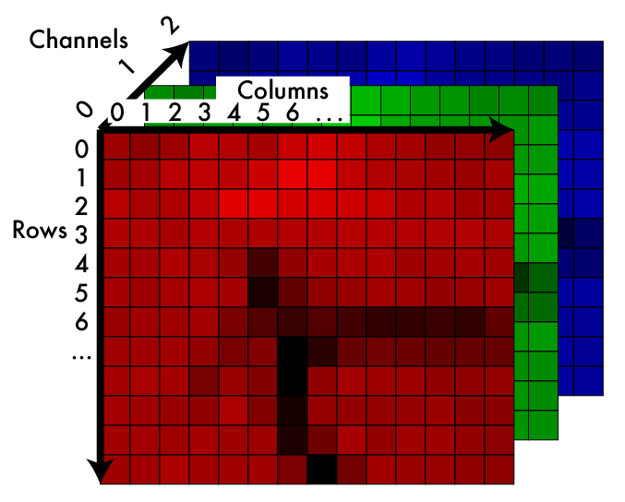
Image: tensor of light values
Addressing pixels:
Size: W x H x C
Index: (x, y, z)
Column x, row y, chan z
Like cartesian but flipped

Slide 5
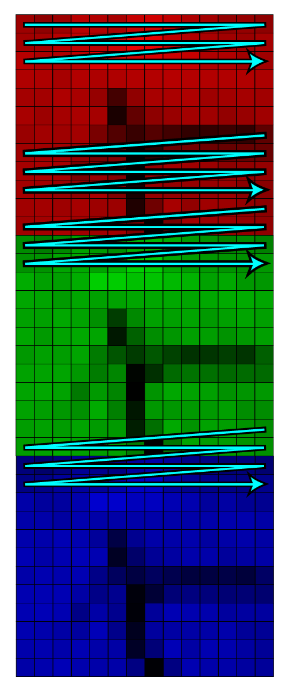
CHW for storing in 1d array
129 | 131 | 152 | ... | 135 | 163 | 142 | ... | 182 | ...

Slide 6
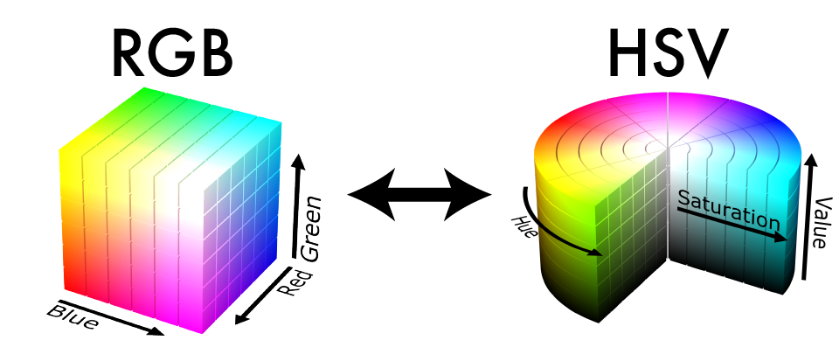
Other colorspaces are fun!

Slide 7
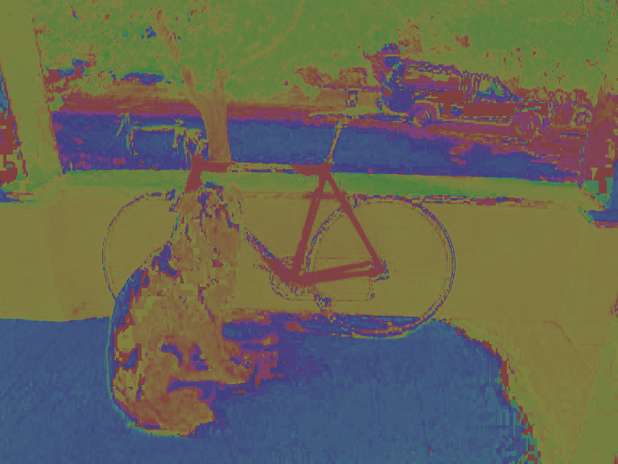
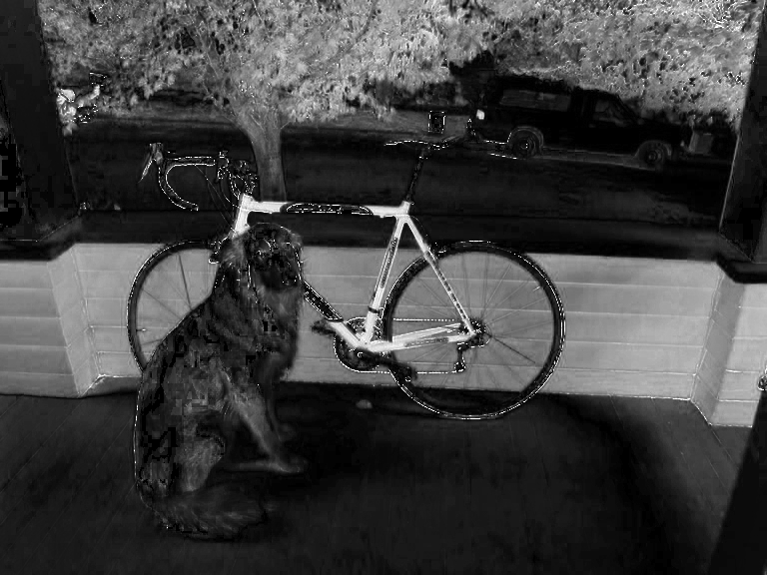
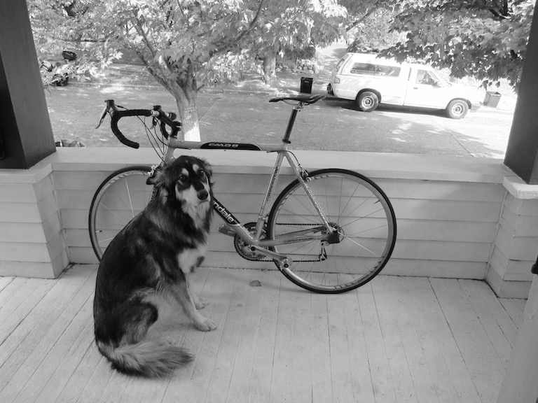

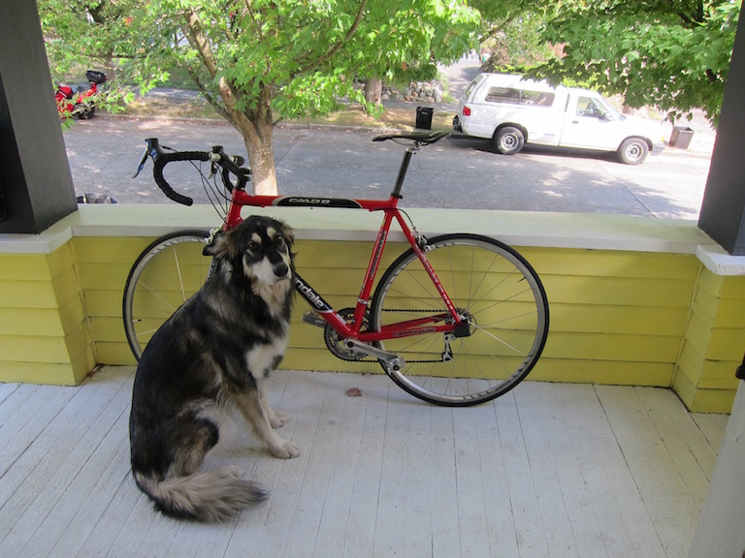
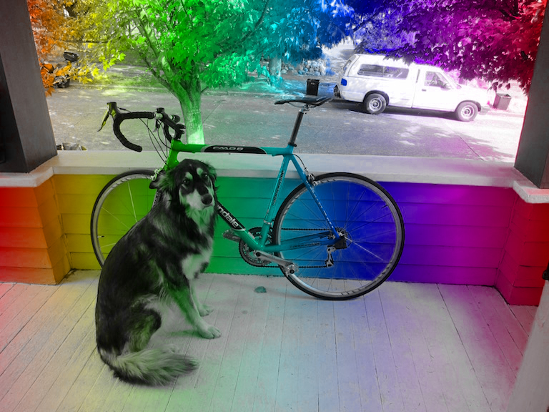
Or pattern...

Slide 8
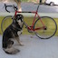

Nearest neighbor: what it sounds like
f(x,y,z) = Im(round(x), round(y), z)
Looks blocky
Common pitfall: Integer division rounds down in C
Note: z is still int

Slide 9
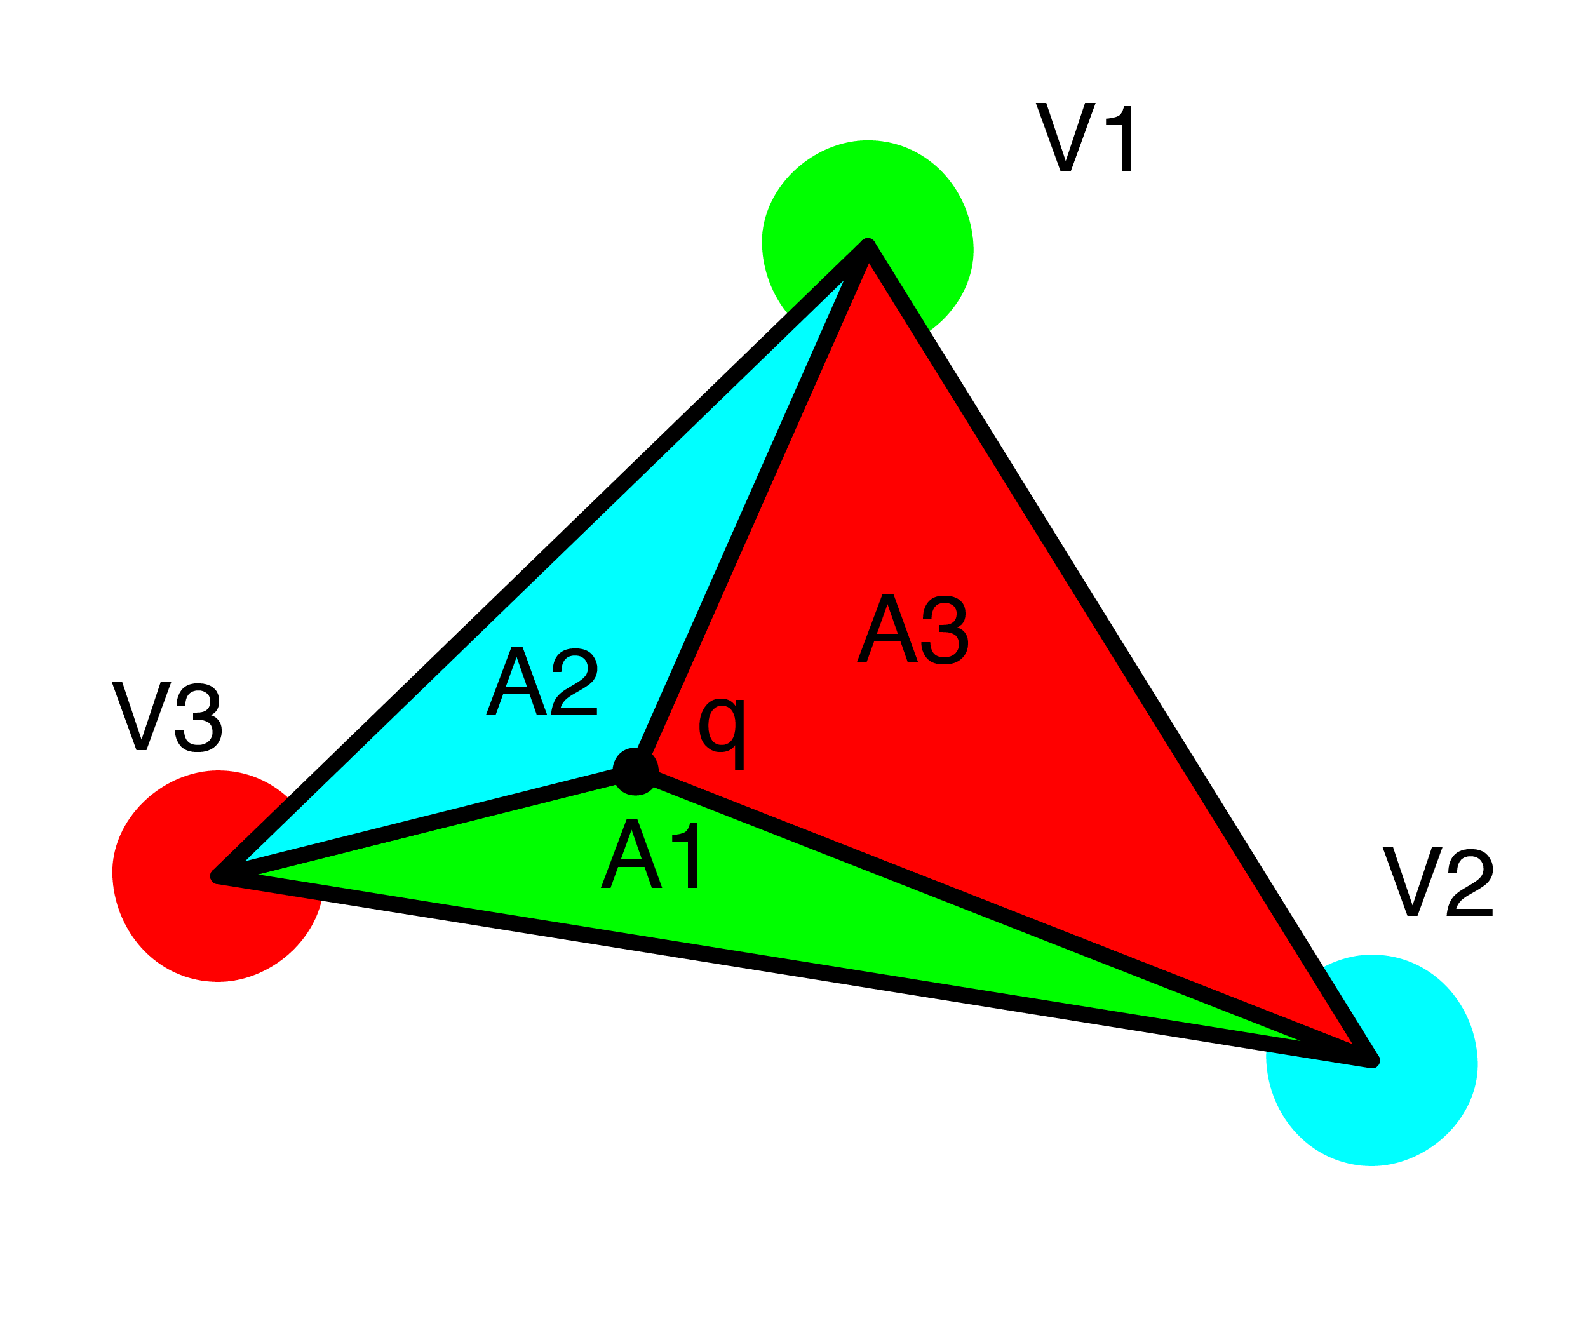
Triangle interpolation: for less structured image
Weighted sum using of triangles:
Q = V1*A1 + V2*A2 + V3*A3
Should normalize this based on total area

Slide 10
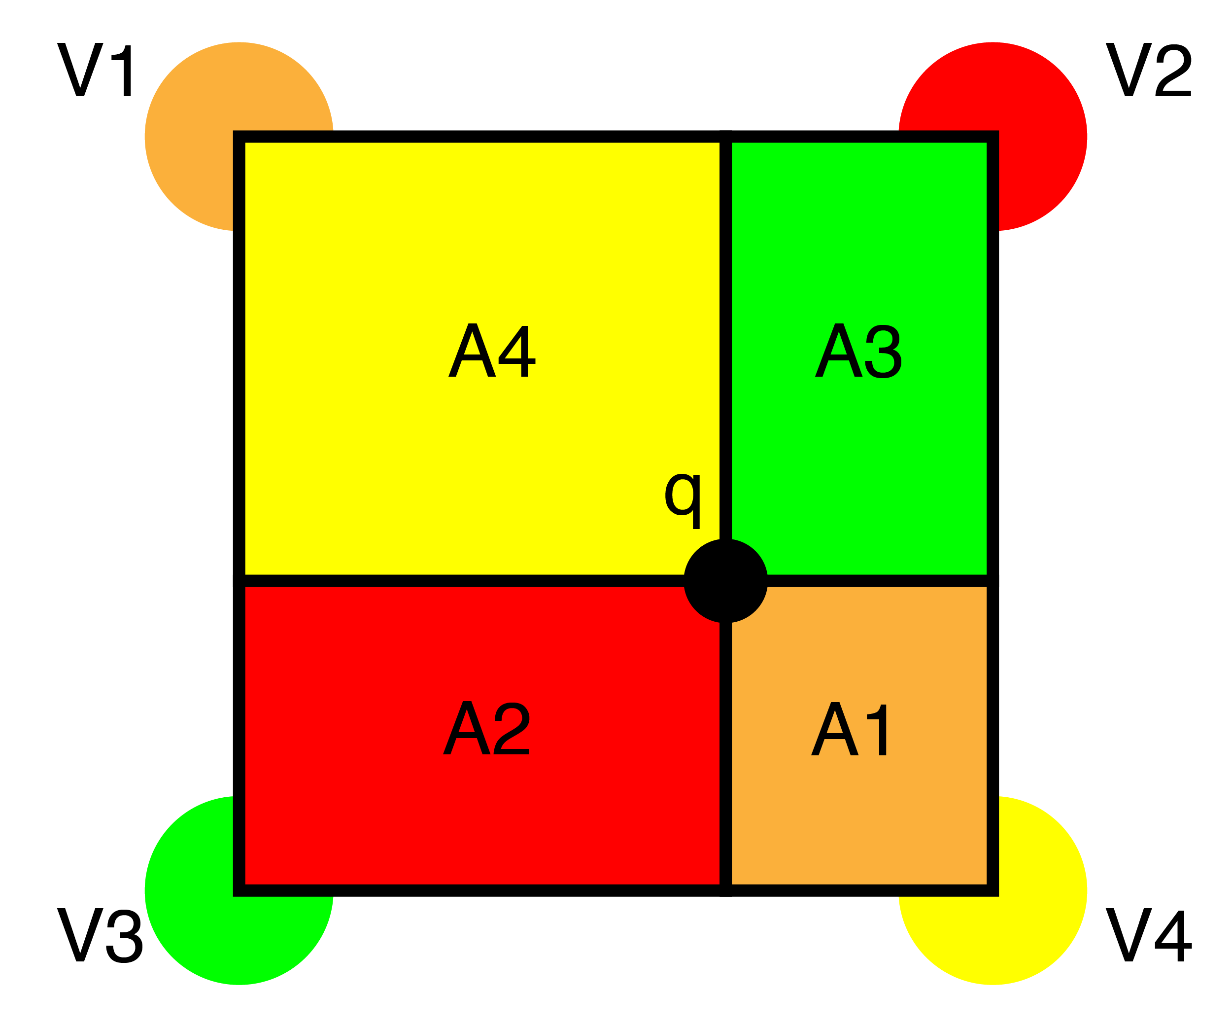
Bilinear interpolation: for grids, pretty good
This time find the closest pixels in a box
Same plan, weighted sum based on area of opposite rectangle
Q = V1*A1 + V2*A2 + V3*A3 + V4*A4
Still need to normalize!
Or do we?

Slide 11
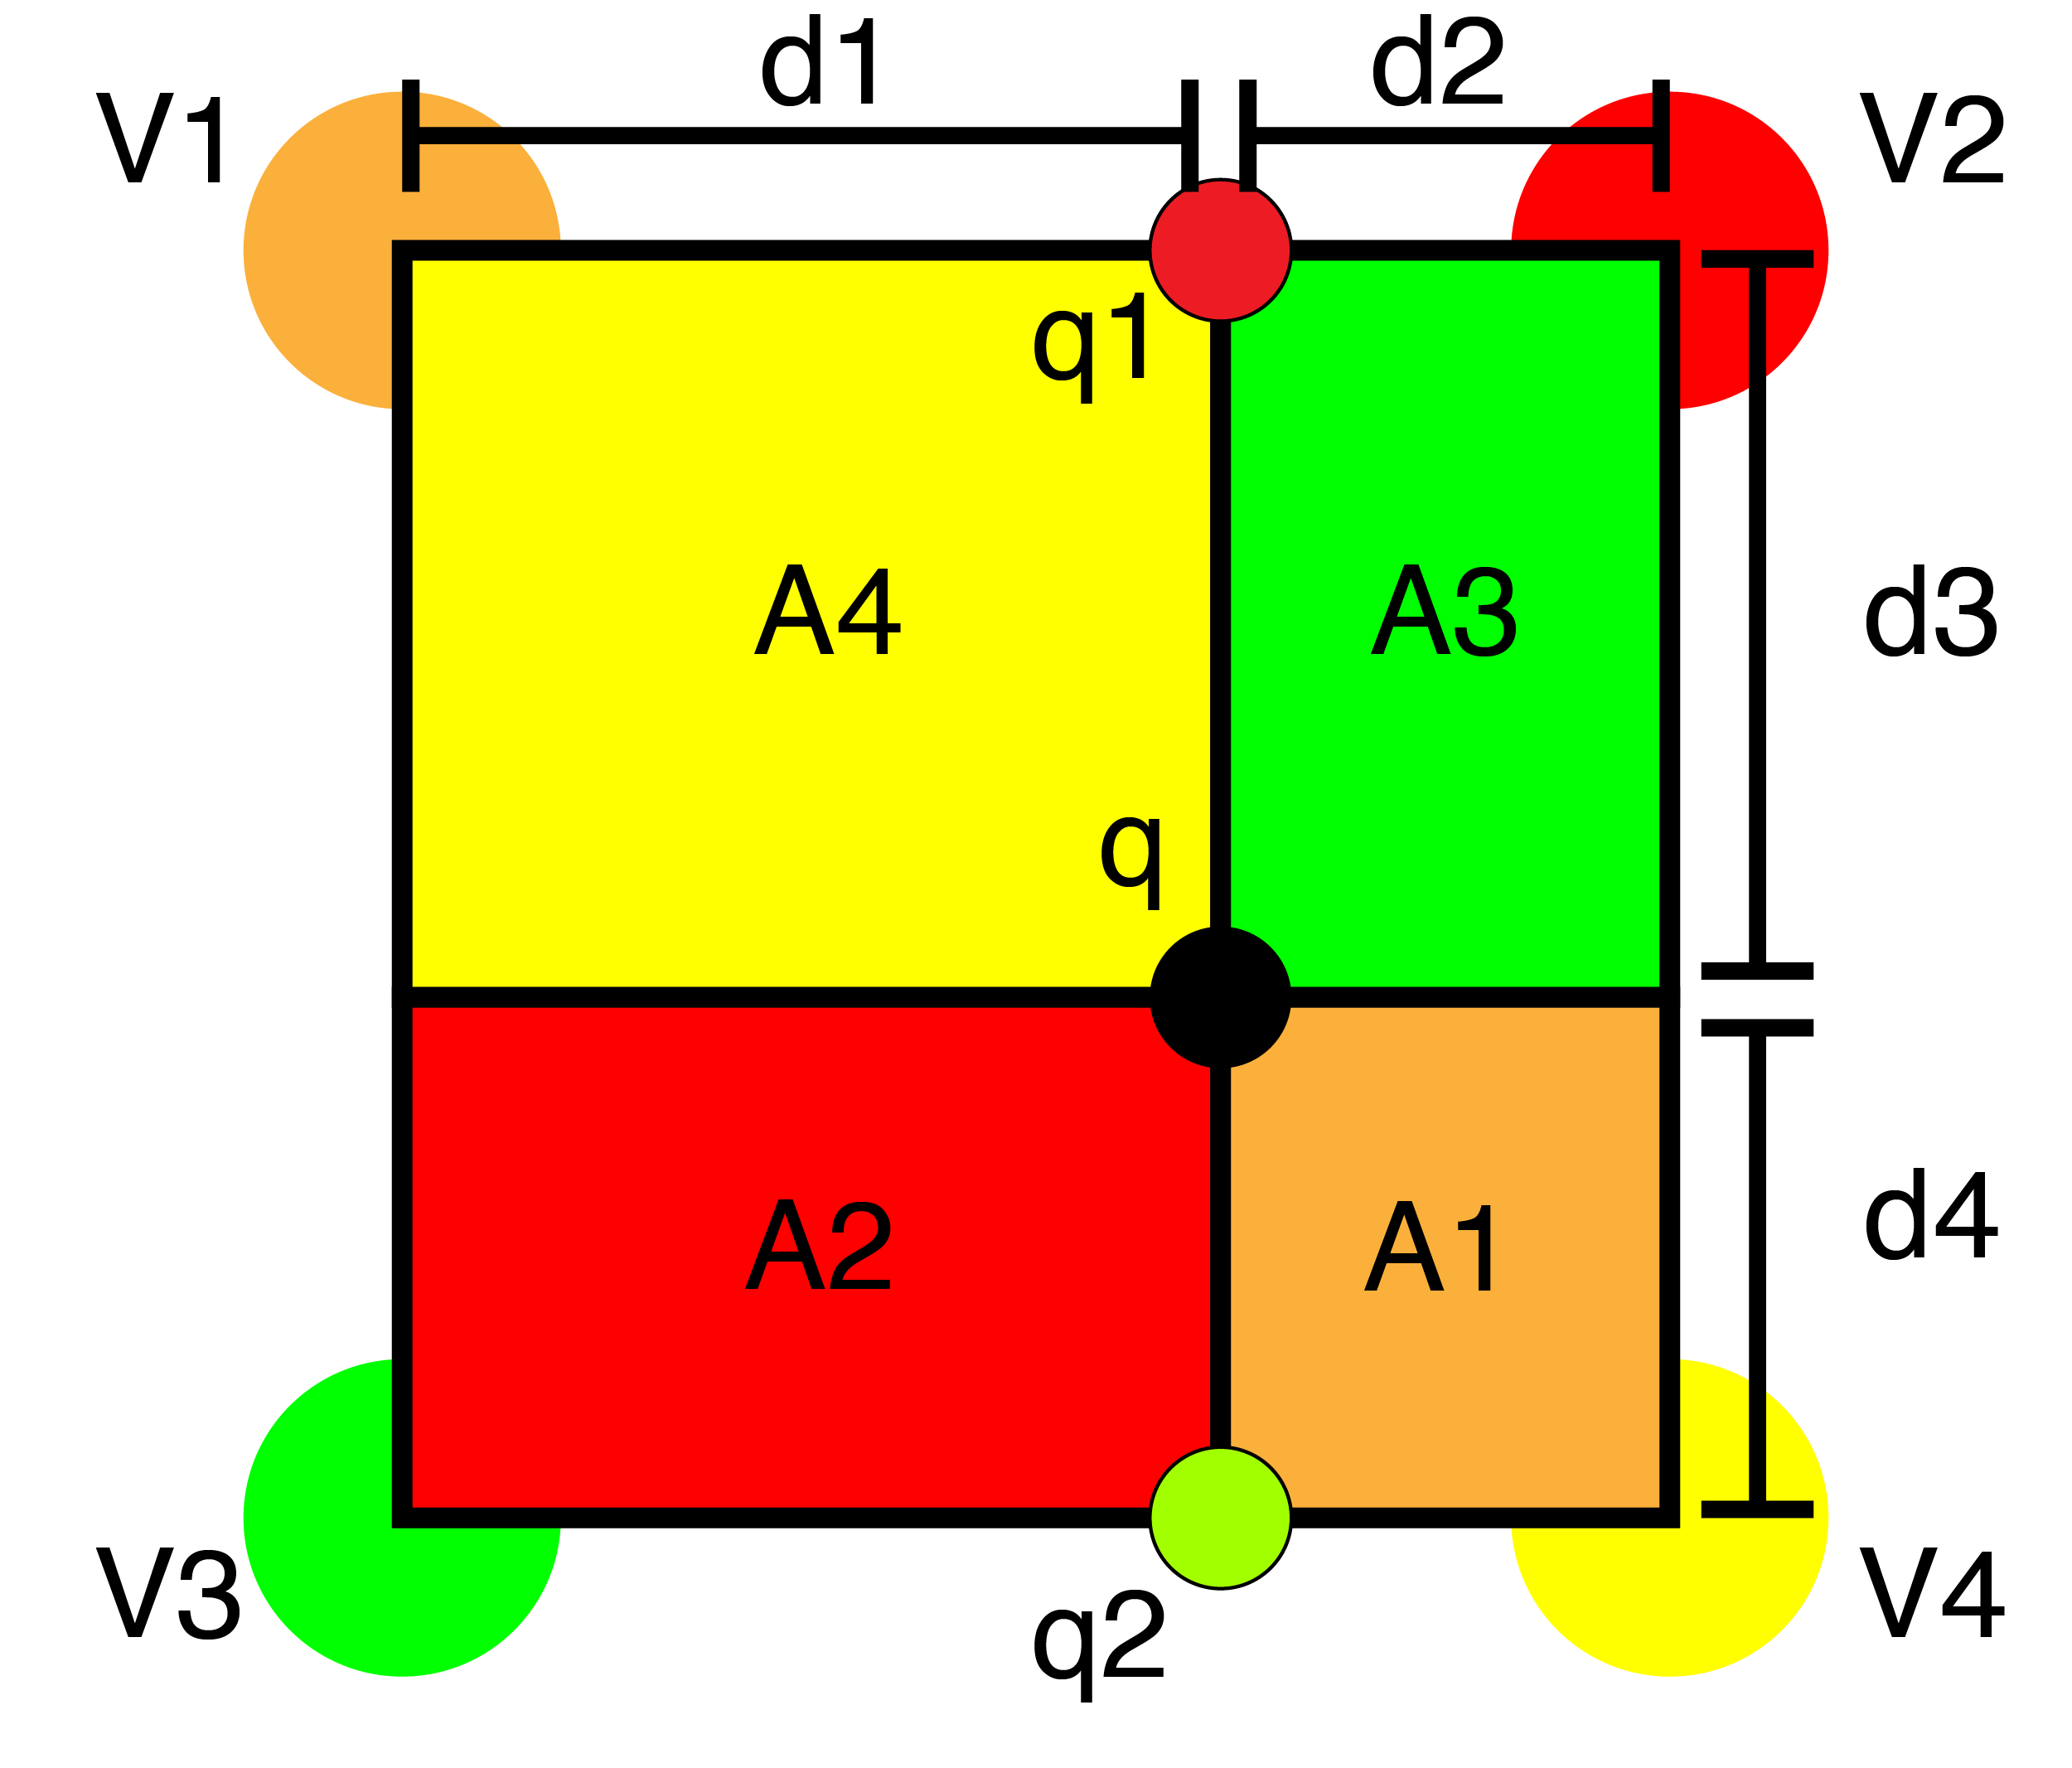
Bilinear interpolation: for grids, pretty good
Alternatively, linear interpolation of linear interpolates
q1 = V1*d2 + V2*d1
q2 = V3*d2 + V4*d1
q = q1*d4 + q2*d3

Slide 12
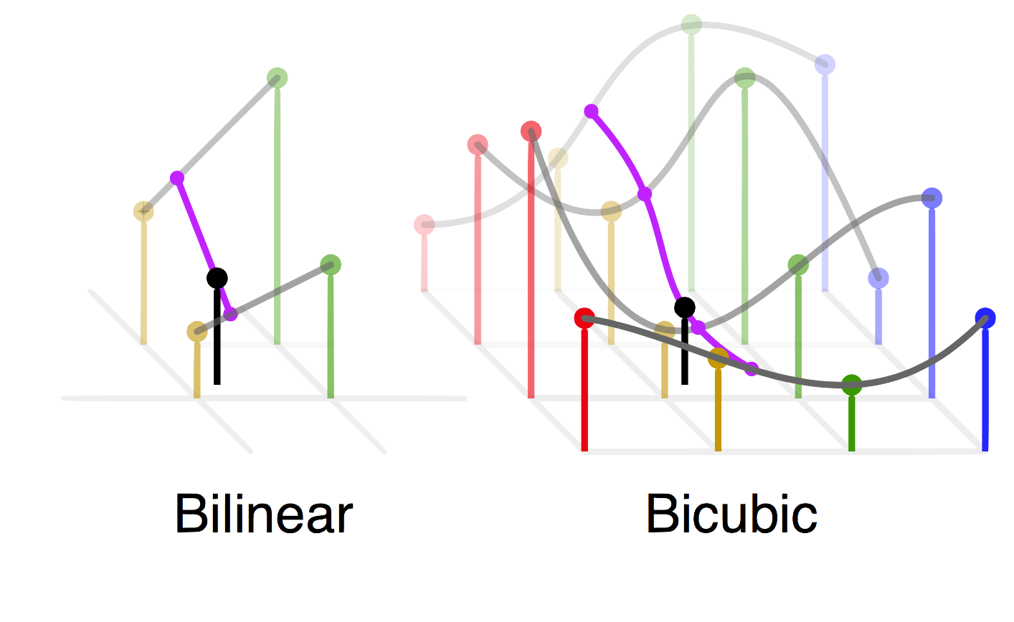
Bicubic sampling: more complex, maybe better?
A cubic interpolation of 4 cubic interpolations
Smoother than bilinear, no “star”
16 nearest neighbors
Fit 3rd order poly:
f(x) = a + bx + cx^2 + dx^3
Interpolate along axis
Fit another poly to interpolated values

Slide 13


Slide 14
So what is this interpolation useful for?

Slide 15
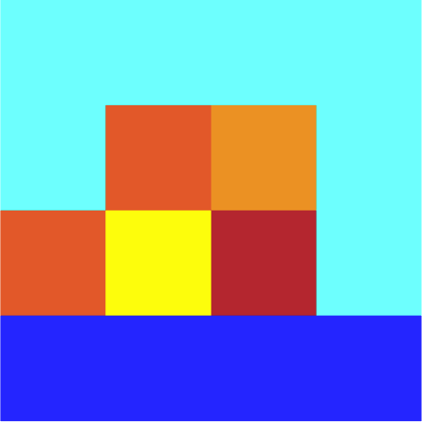
Image resizing!
Say we want to increase the size of an image…
This is a beautiful image of a sunset… it’s just very small…

Slide 16
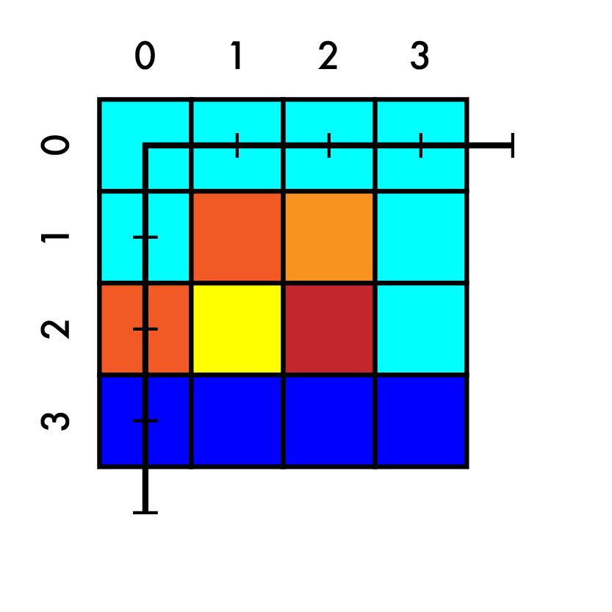
Image resizing!
Say we want to increase the size of an image…
This is a beautiful image of a sunset… it’s just very small…
Say we want to increase size 4x4 -> 7x7

Slide 17
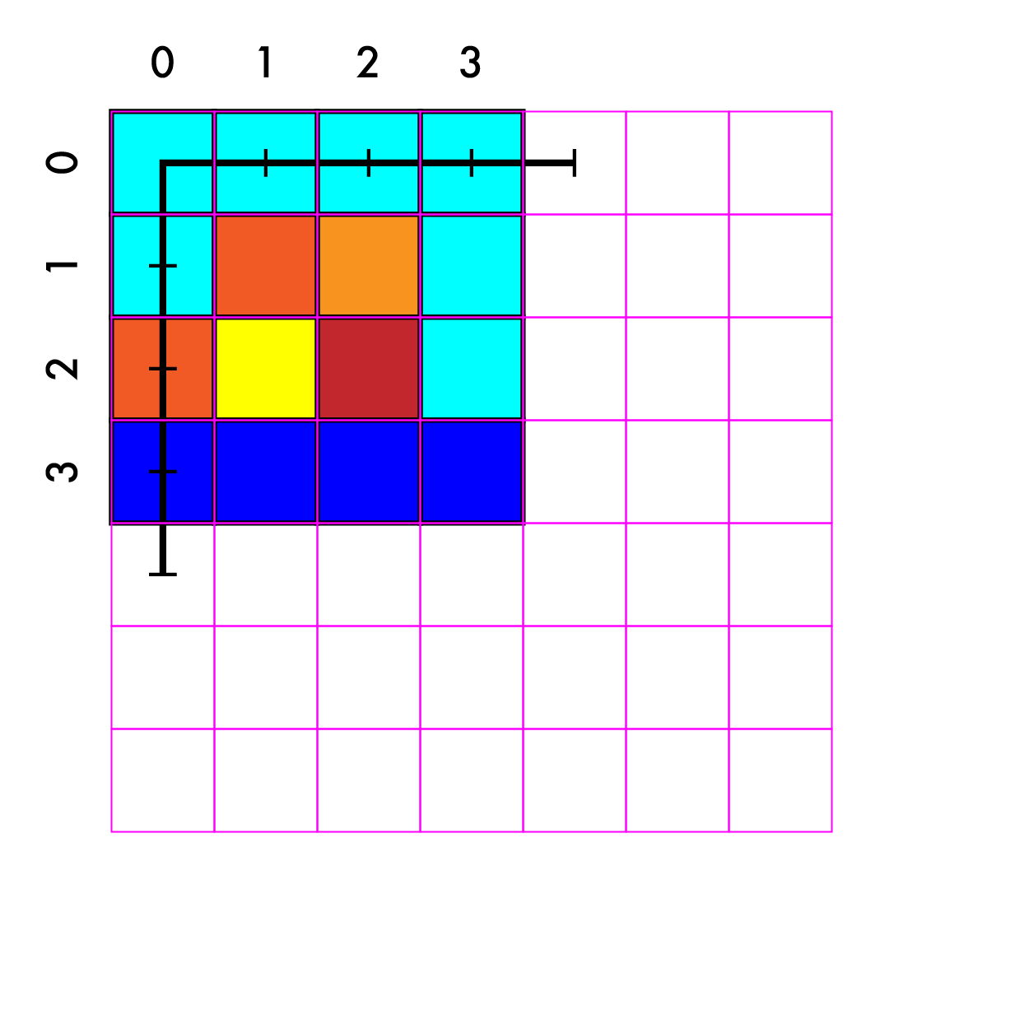
Resize 4x4 -> 7x7
Create our new image

Slide 18
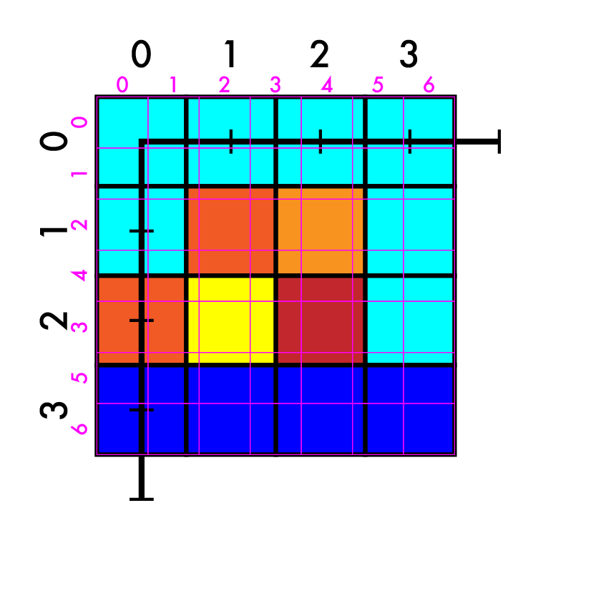
Resize 4x4 -> 7x7
Create our new image
Match up coordinates

Slide 19
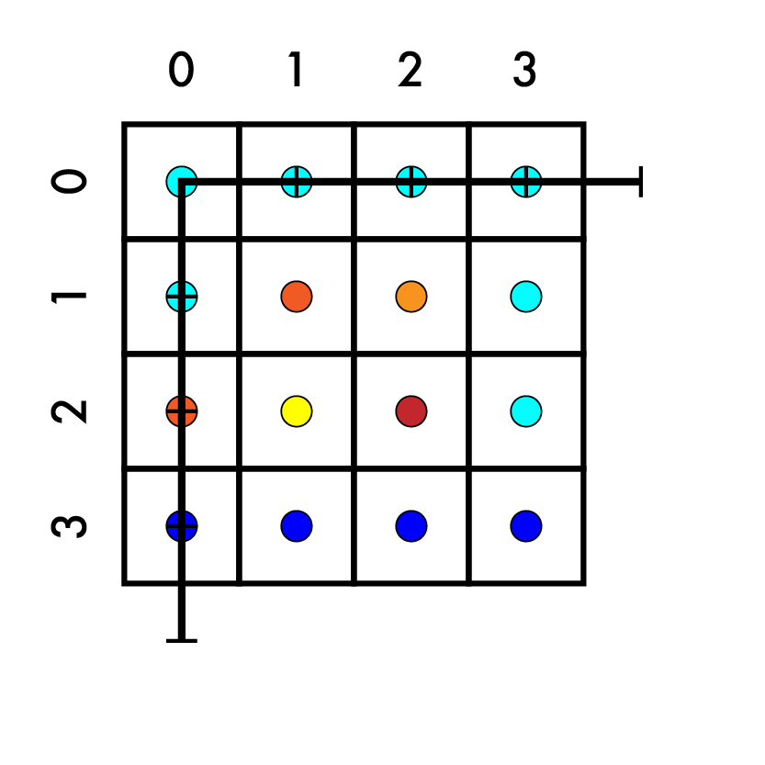
Resize 4x4 -> 7x7
Create our new image
Match up coordinates

Slide 20
Resize 4x4 -> 7x7
Create our new image
Match up coordinates
(-0.5, -0.5)
(3.5, 3.5)

Slide 21
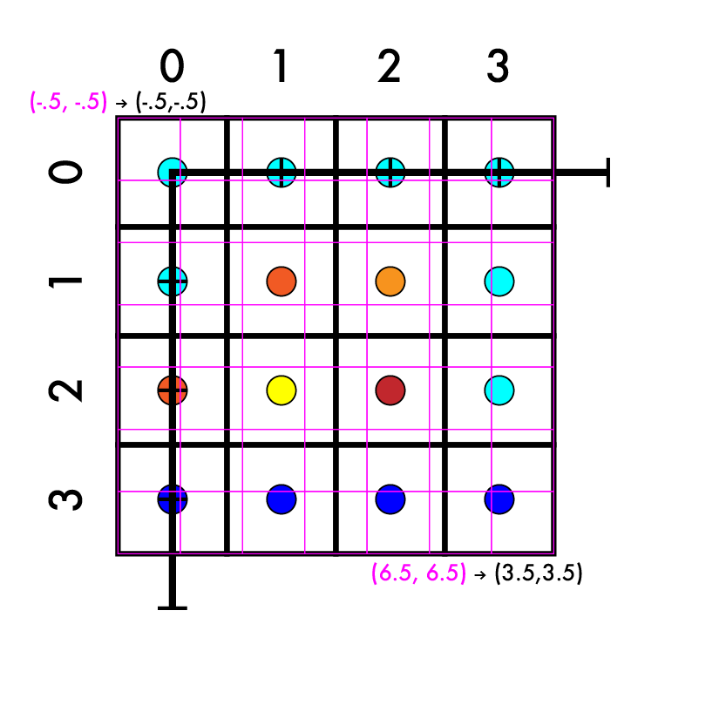
Resize 4x4 -> 7x7
Create our new image
Match up coordinates
System of equations
aX + b = Y
a*-.5 + b = -.5
a*6.5 + b = 3.5

Slide 22
Resize 4x4 -> 7x7
Create our new image
Match up coordinates
System of equations
aX + b = Y
a*-.5 + b = -.5
a*6.5 + b = 3.5
a*7 = 4

Slide 23
Resize 4x4 -> 7x7
Create our new image
Match up coordinates
System of equations
aX + b = Y
a*-.5 + b = -.5
a*6.5 + b = 3.5
a*7 = 4
a = 4/7

Slide 24
Resize 4x4 -> 7x7
Create our new image
Match up coordinates
System of equations
aX + b = Y
a*-.5 + b = -.5
a*6.5 + b = 3.5
a = 4/7

Slide 25
Resize 4x4 -> 7x7
Create our new image
Match up coordinates
System of equations
aX + b = Y
a*-.5 + b = -.5
a*6.5 + b = 3.5
a = 4/7
a*-.5 + b = -.5

Slide 26
Resize 4x4 -> 7x7
Create our new image
Match up coordinates
System of equations
aX + b = Y
a*-.5 + b = -.5
a*6.5 + b = 3.5
a = 4/7
a*-.5 + b = -.5
4/7*-1/2 + b = -1/2

Slide 27
Resize 4x4 -> 7x7
Create our new image
Match up coordinates
System of equations
aX + b = Y
a*-.5 + b = -.5
a*6.5 + b = 3.5
a = 4/7
a*-.5 + b = -.5
4/7*-1/2 + b = -1/2
-4/14 + b = -7/14

Slide 28
Resize 4x4 -> 7x7
Create our new image
Match up coordinates
System of equations
aX + b = Y
a*-.5 + b = -.5
a*6.5 + b = 3.5
a = 4/7
a*-.5 + b = -.5
4/7*-1/2 + b = -1/2
-4/14 + b = -7/14
b = -3/14

Slide 29
Resize 4x4 -> 7x7
Create our new image
Match up coordinates
System of equations
aX + b = Y
a*-.5 + b = -.5
a*6.5 + b = 3.5
a = 4/7
b = -3/14

Slide 30
Resize 4x4 -> 7x7
Create our new image
Match up coordinates
4/7 X - 3/14 = Y

Slide 31
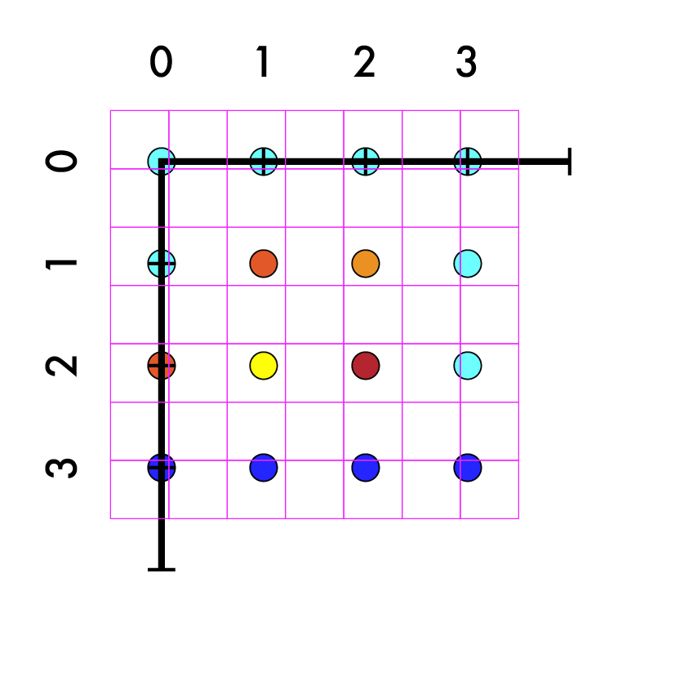
Resize 4x4 -> 7x7
Create our new image
Match up coordinates
4/7 X - 3/14 = Y

Slide 32
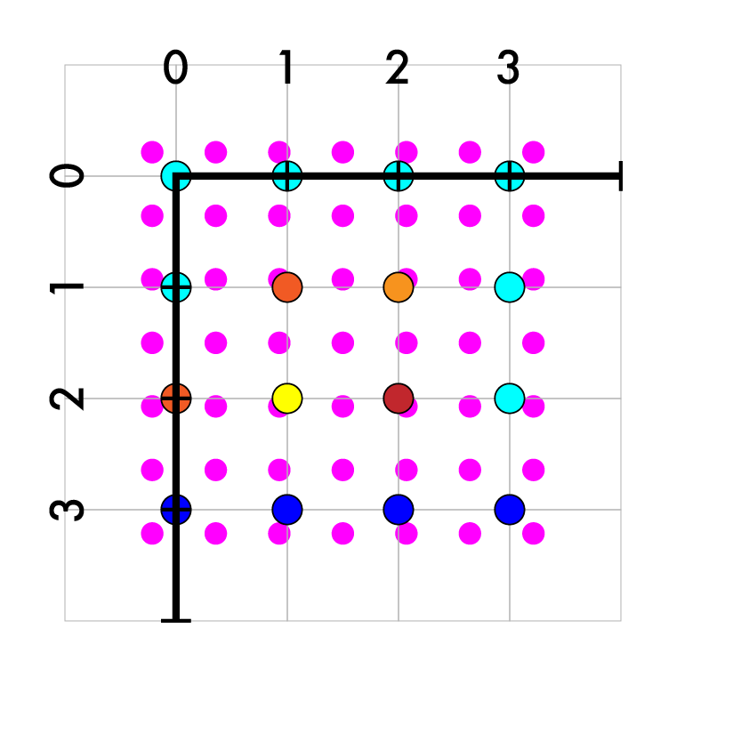
Resize 4x4 -> 7x7
Create our new image
Match up coordinates
4/7 X - 3/14 = Y
Iterate over new pts

Slide 33
Resize 4x4 -> 7x7
Create our new image
Match up coordinates
4/7 X - 3/14 = Y
Iterate over new pts
Map to old coords

Slide 34
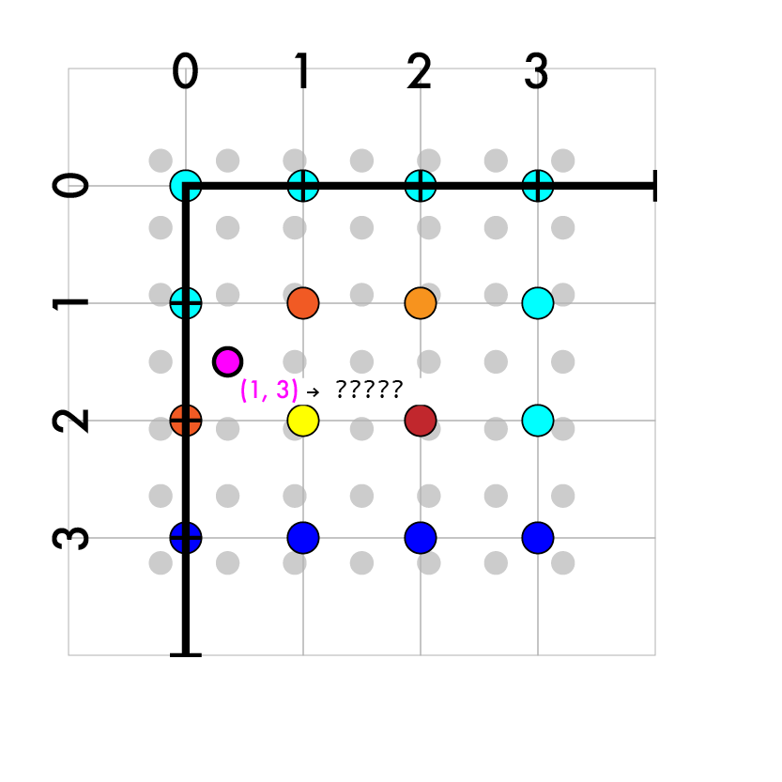
Resize 4x4 -> 7x7
Create our new image
Match up coordinates
4/7 X - 3/14 = Y
Iterate over new pts
Map to old coords
(1, 3)

Slide 35
Resize 4x4 -> 7x7
Create our new image
Match up coordinates
4/7 X - 3/14 = Y
Iterate over new pts
Map to old coords
(1, 3)
4/7*1 - 3/14
4/7*3 - 3/14

Slide 36
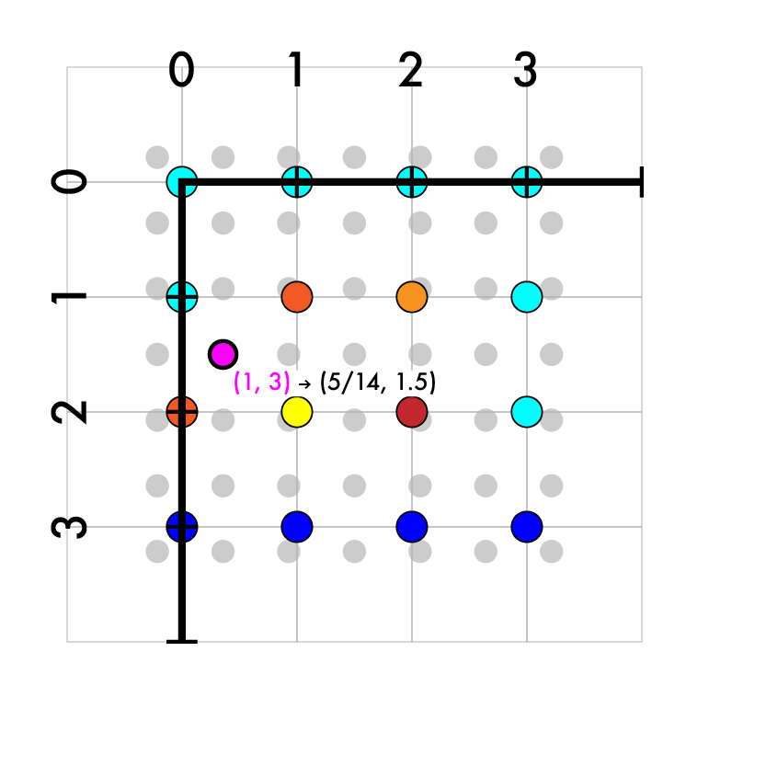
Resize 4x4 -> 7x7
Create our new image
Match up coordinates
4/7 X - 3/14 = Y
Iterate over new pts
Map to old coords
(1, 3)
4/7*1 - 3/14
4/7*3 - 3/14
(5/14, 7/14)

Slide 37
Resize 4x4 -> 7x7
Create our new image
Match up coordinates
4/7 X - 3/14 = Y
Iterate over new pts
Map to old coords
(1, 3) -> (5/14, 7/14)

Slide 38
Resize 4x4 -> 7x7
Create our new image
Match up coordinates
4/7 X - 3/14 = Y
Iterate over new pts
Map to old coords
(1, 3) -> (5/14, 7/14)
Interpolate old values

Slide 39
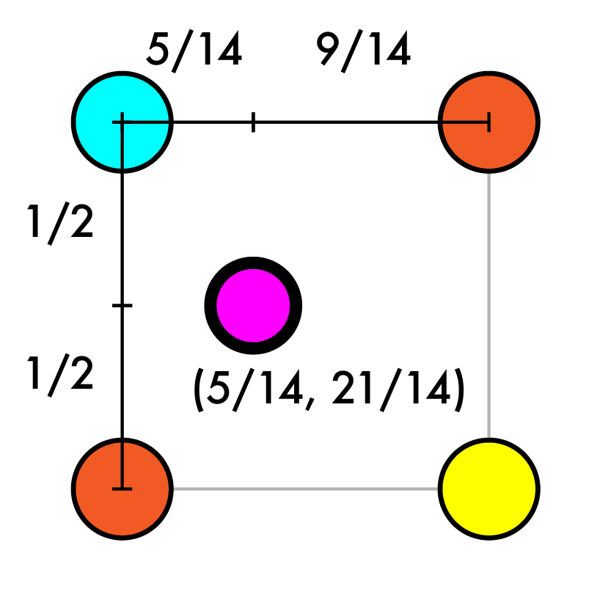
Resize 4x4 -> 7x7
Create our new image
Match up coordinates
4/7 X - 3/14 = Y
Iterate over new pts
Map to old coords
(1, 3) -> (5/14, 7/14)
Interpolate old values

Slide 40
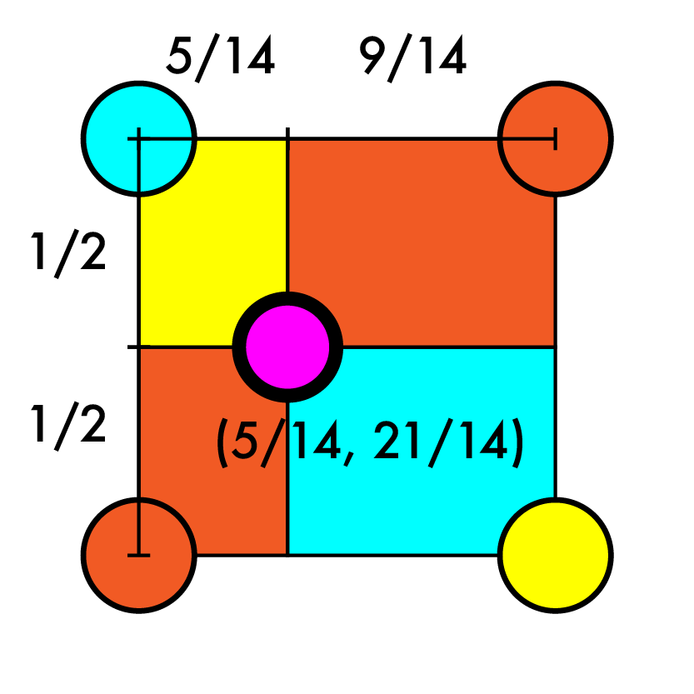
Resize 4x4 -> 7x7
Create our new image
Match up coordinates
4/7 X - 3/14 = Y
Iterate over new pts
Map to old coords
(1, 3) -> (5/14, 7/14)
Interpolate old values
Size of opposite rects

Slide 41
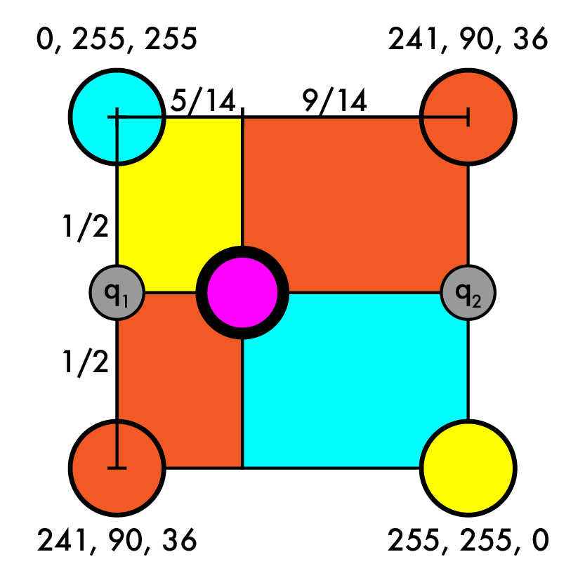
Resize 4x4 -> 7x7
Create our new image
Match up coordinates
4/7 X - 3/14 = Y
Iterate over new pts
Map to old coords
(1, 3) -> (5/14, 7/14)
Interpolate old values
Size of opposite rects
OR find q1 and q2, then interpolate between them

Slide 42
Resize 4x4 -> 7x7
Create our new image
Match up coordinates
4/7 X - 3/14 = Y
Iterate over new pts
Map to old coords
(1, 3) -> (5/14, 7/14)
Interpolate old values
q1 = r1, g1, b1
r1 = .5*0 + .5*241
g1 = .5*255 + .5*90
b1 = .5*241 + .5*36

Slide 43
Resize 4x4 -> 7x7
Create our new image
Match up coordinates
4/7 X - 3/14 = Y
Iterate over new pts
Map to old coords
(1, 3) -> (5/14, 7/14)
Interpolate old values
q1 = r1, g1, b1
r1 = .5*0 + .5*241
g1 = .5*255 + .5*90
b1 = .5*241 + .5*36

Slide 44
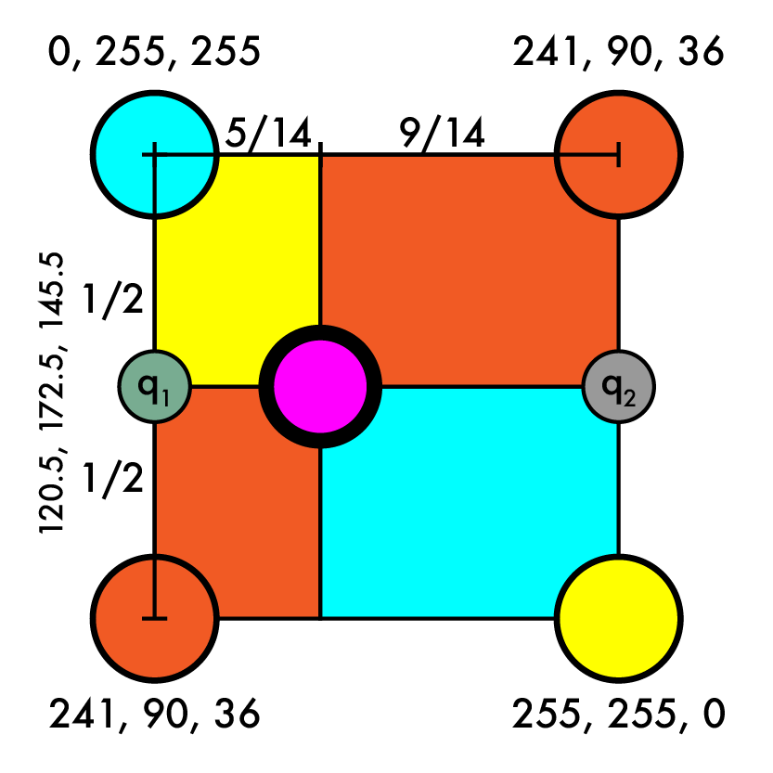
Resize 4x4 -> 7x7
Create our new image
Match up coordinates
4/7 X - 3/14 = Y
Iterate over new pts
Map to old coords
(1, 3) -> (5/14, 7/14)
Interpolate old values
q1 = (120.5, 172.5, 145.5)
q2 = r2, g2, b2

Slide 45
Resize 4x4 -> 7x7
Create our new image
Match up coordinates
4/7 X - 3/14 = Y
Iterate over new pts
Map to old coords
(1, 3) -> (5/14, 7/14)
Interpolate old values
q1 = (120.5, 172.5, 145.5)
q2 = r2, g2, b2

Slide 46
Resize 4x4 -> 7x7
Create our new image
Match up coordinates
4/7 X - 3/14 = Y
Iterate over new pts
Map to old coords
(1, 3) -> (5/14, 7/14)
Interpolate old values
q1 = (120.5, 172.5, 145.5)
q2 = r2, g2, b2
r2 = .5*241 + .5*255
g2 = .5*90 + .5*255
b2 = .5*36 + .5*0

Slide 47
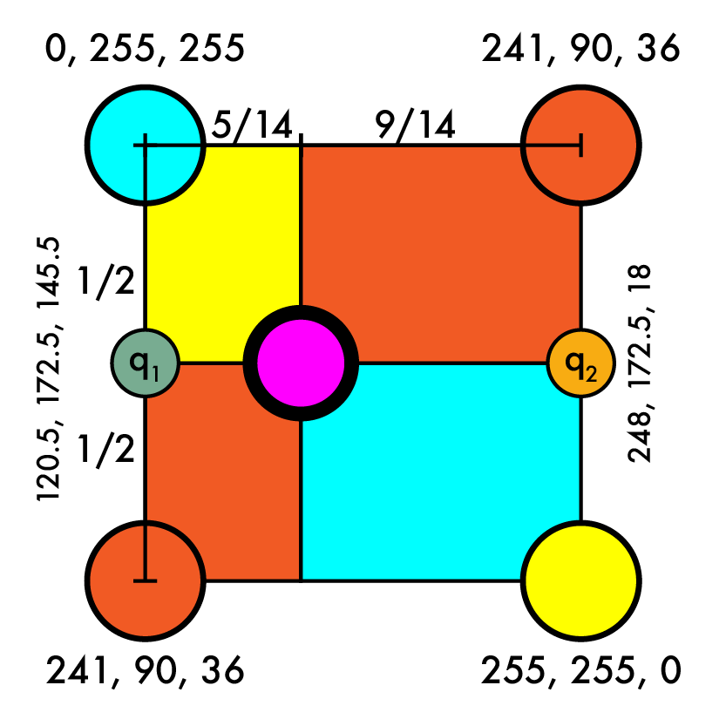
Resize 4x4 -> 7x7
Create our new image
Match up coordinates
4/7 X - 3/14 = Y
Iterate over new pts
Map to old coords
(1, 3) -> (5/14, 7/14)
Interpolate old values
q1 = (120.5, 172.5, 145.5)
q2 = (248, 172.5, 18)

Slide 48
Resize 4x4 -> 7x7
Create our new image
Match up coordinates
4/7 X - 3/14 = Y
Iterate over new pts
Map to old coords
(1, 3) -> (5/14, 7/14)
Interpolate old values
q1 = (120.5, 172.5, 145.5)
q2 = (248, 172.5, 18)
q = r, g, b
w = 9/14*w1 + 5/14 w2

Slide 49
Resize 4x4 -> 7x7
Create our new image
Match up coordinates
4/7 X - 3/14 = Y
Iterate over new pts
Map to old coords
(1, 3) -> (5/14, 7/14)
Interpolate old values
q1 = (120.5, 172.5, 145.5)
q2 = (248, 172.5, 18)
q = r, g, b
w = 9/14*w1 + 5/14 w2
r = 9/14*120.5 + 5/14*248
g = 9/14*172.5 + 5/14*172.5
b = 9/14*145.5 + 5/14*18

Slide 50
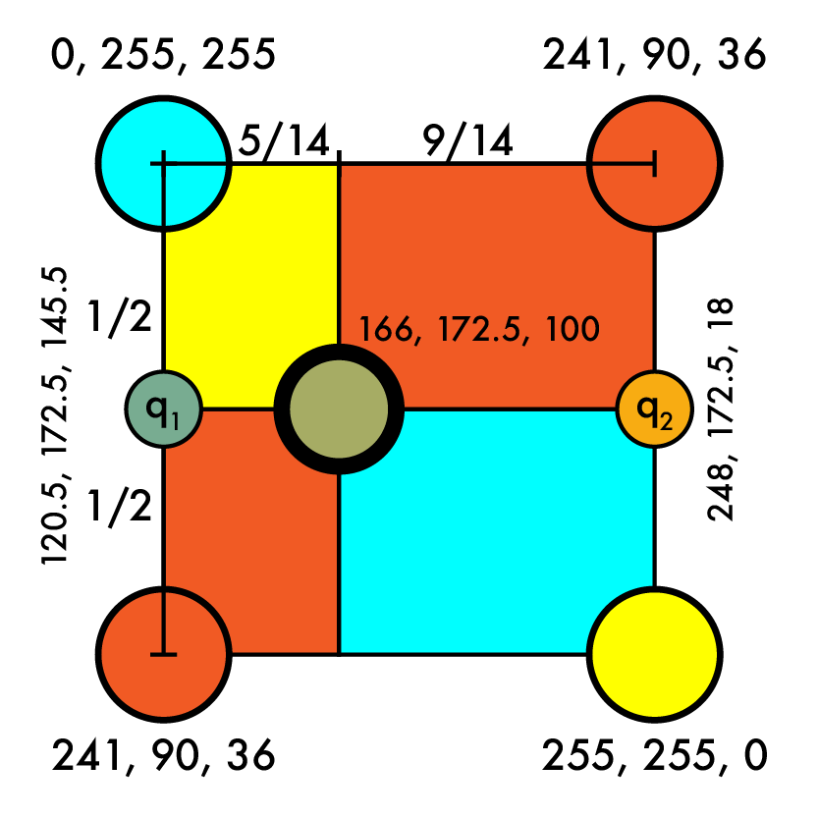
Resize 4x4 -> 7x7
Create our new image
Match up coordinates
4/7 X - 3/14 = Y
Iterate over new pts
Map to old coords
(1, 3) -> (5/14, 7/14)
Interpolate old values
q1 = (120.5, 172.5, 145.5)
q2 = (248, 172.5, 18)
q = (166, 172.5, 100)

Slide 51
Resize 4x4 -> 7x7
Create our new image
Match up coordinates
4/7 X - 3/14 = Y
Iterate over new pts
Map to old coords
(1, 3) -> (5/14, 7/14)
Interpolate old values
q = (166, 172.5, 100)

Slide 52
Resize 4x4 -> 7x7
Create our new image
Match up coordinates
4/7 X - 3/14 = Y
Iterate over new pts
Map to old coords
(1, 3) -> (5/14, 7/14)
Interpolate old values
q = (166, 172.5, 100)

Slide 53
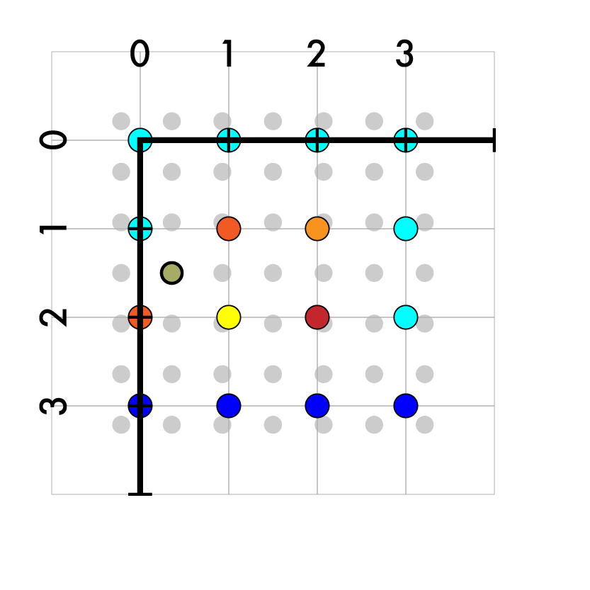
Resize 4x4 -> 7x7
Create our new image
Match up coordinates
4/7 X - 3/14 = Y
Iterate over new pts
Map to old coords
(1, 3) -> (5/14, 7/14)
Interpolate old values
q = (166, 172.5, 100)

Slide 54
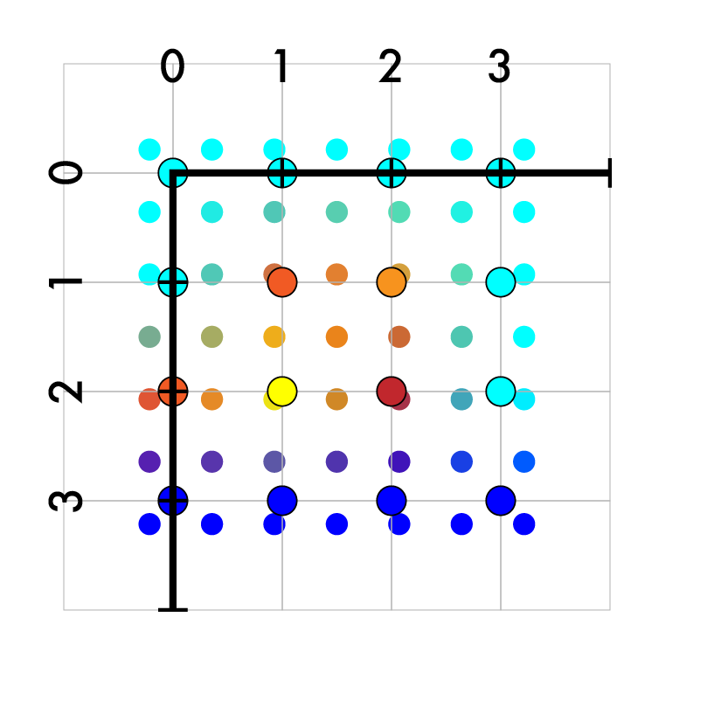
Resize 4x4 -> 7x7
Create our new image
Match up coordinates
4/7 X - 3/14 = Y
Iterate over new pts
Map to old coords
(1, 3) -> (5/14, 7/14)
Interpolate old values
q = (166, 172.5, 100)
Fill in the rest

Slide 55
Resize 4x4 -> 7x7
Create our new image
Match up coordinates
4/7 X - 3/14 = Y
Iterate over new pts
Map to old coords
(1, 3) -> (5/14, 7/14)
Interpolate old values
q = (166, 172.5, 100)
Fill in the rest
On outer edges use padding!

Slide 56
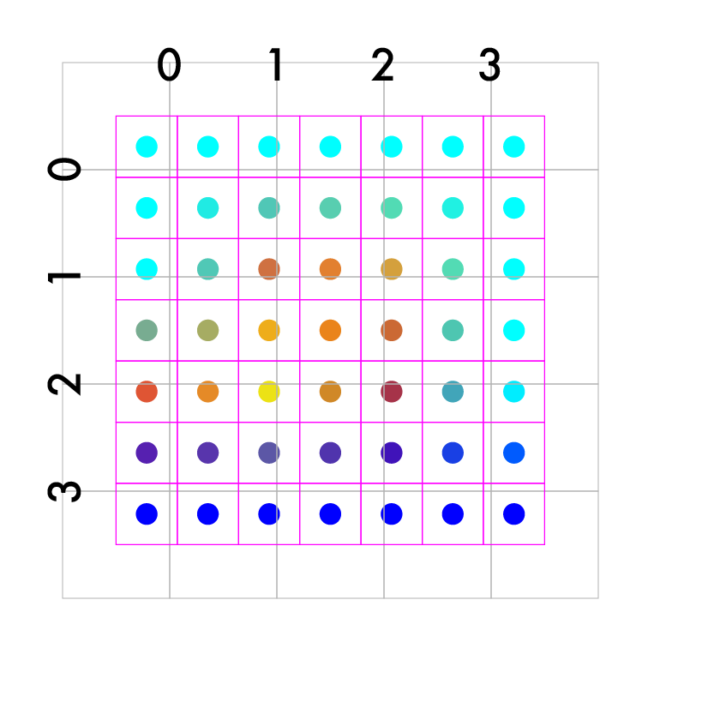
Resize 4x4 -> 7x7
Create our new image
Match up coordinates
4/7 X - 3/14 = Y
Iterate over new pts
Map to old coords
(1, 3) -> (5/14, 7/14)
Interpolate old values
q = (166, 172.5, 100)
Fill in the rest

Slide 57
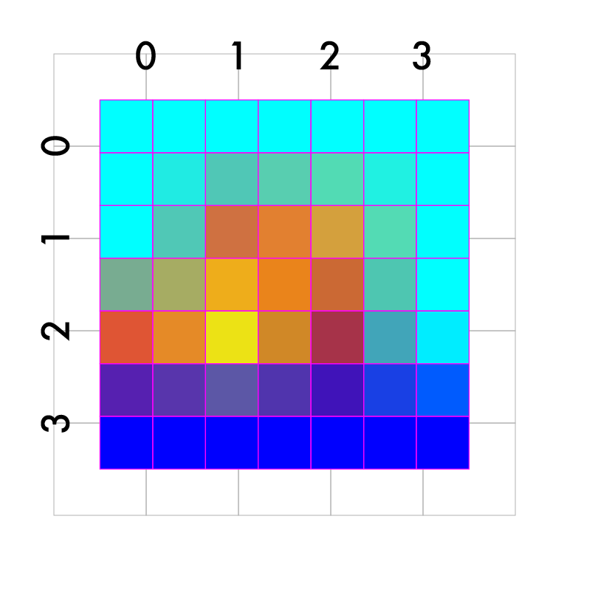
Resize 4x4 -> 7x7
Create our new image
Match up coordinates
4/7 X - 3/14 = Y
Iterate over new pts
Map to old coords
(1, 3) -> (5/14, 7/14)
Interpolate old values
q = (166, 172.5, 100)
Fill in the rest

Slide 58
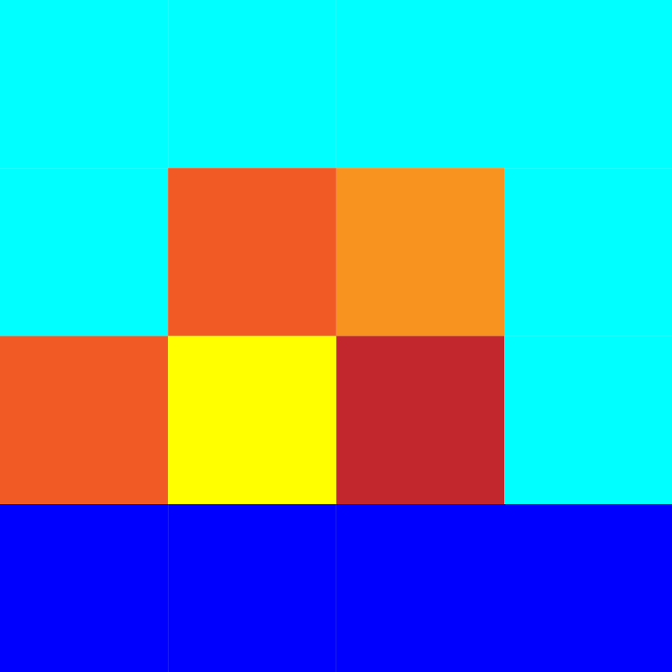

We did it!

Slide 59
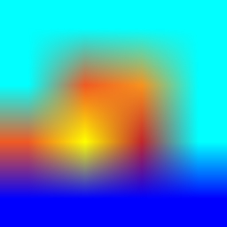
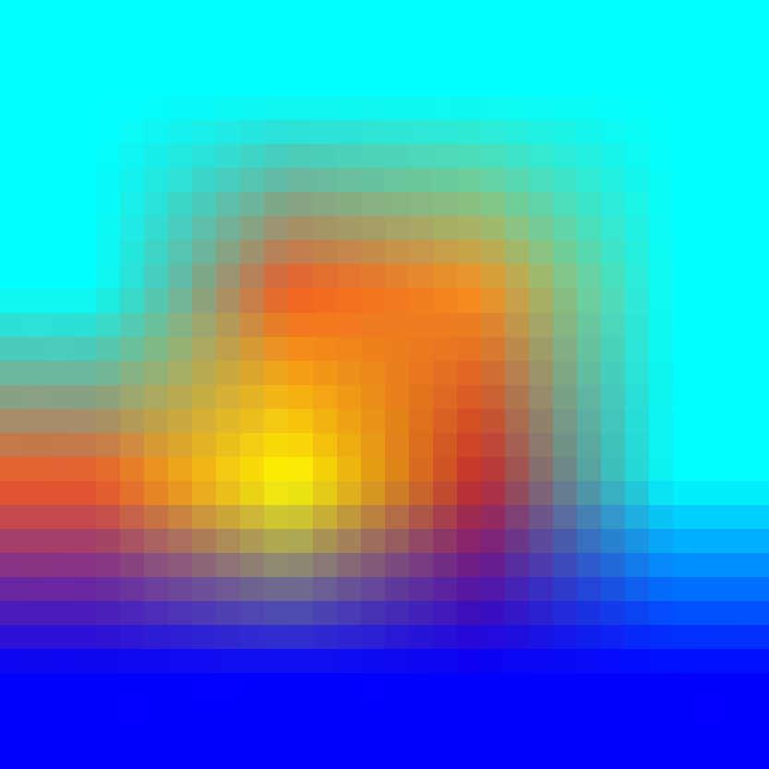
Different scales

Slide 60


Different methods

Slide 61
Let’s do something interesting already!!

Slide 62
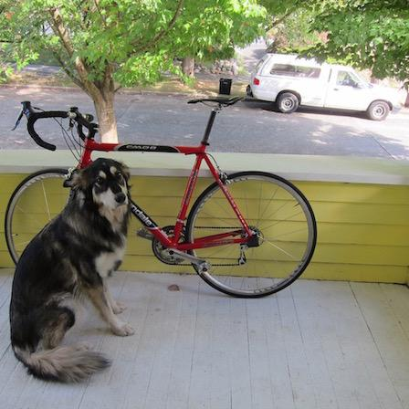
Want to make image smaller

Slide 63
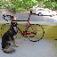
448x448 -> 64x64

Slide 64

448x448 -> 64x64

Slide 65
448x448 -> 64x64

Slide 66

448x448 -> 64x64

Slide 67
448x448 -> 64x64

Slide 68
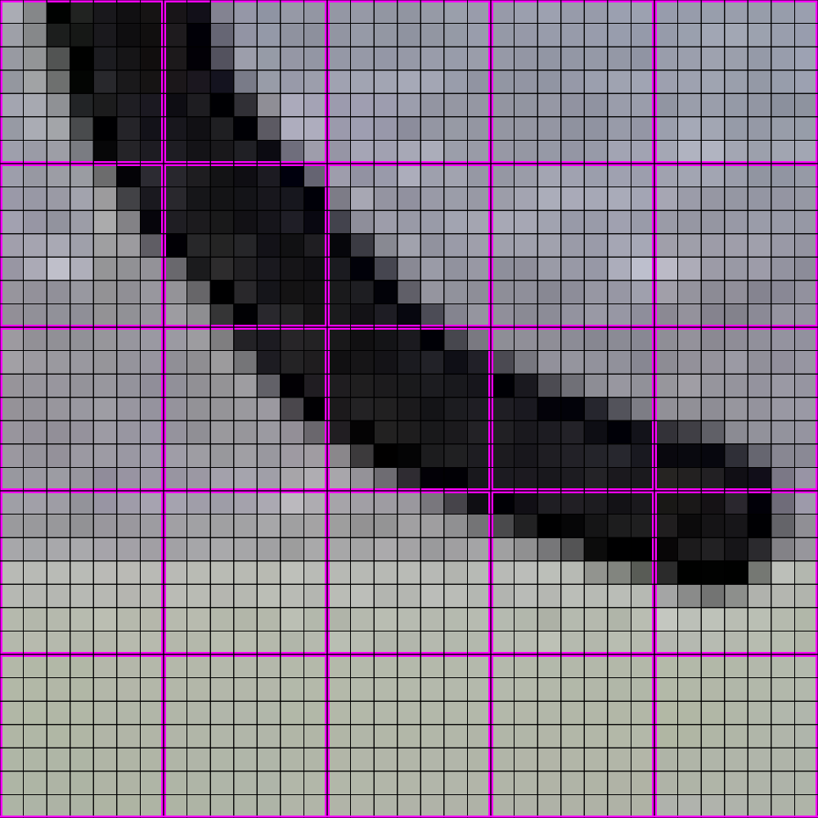
448x448 -> 64x64

Slide 69

448x448 -> 64x64

Slide 70
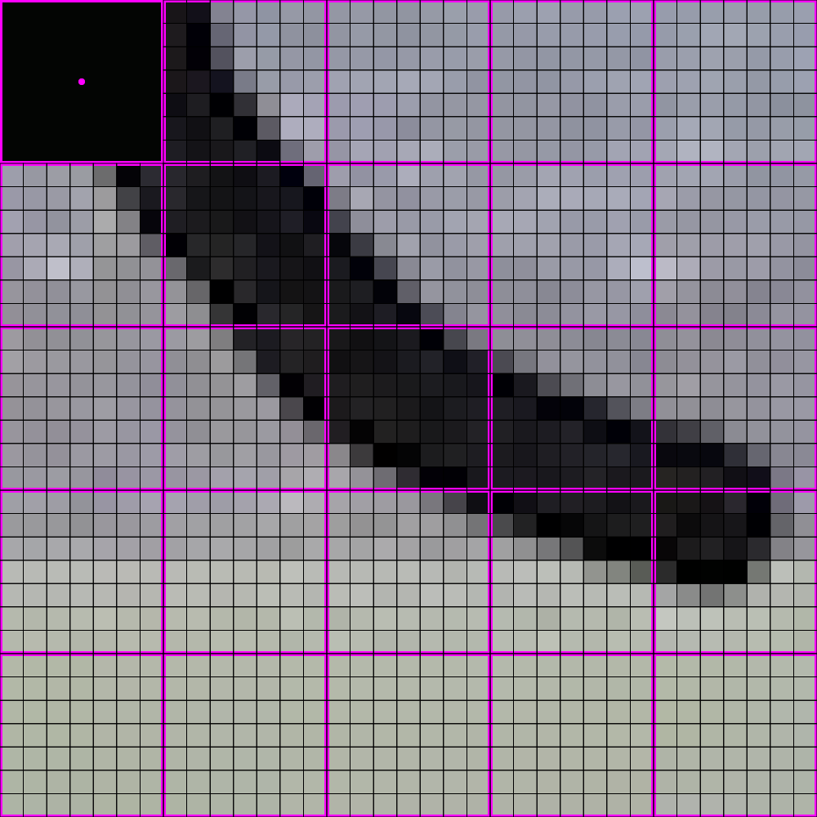
448x448 -> 64x64

Slide 71

448x448 -> 64x64

Slide 72
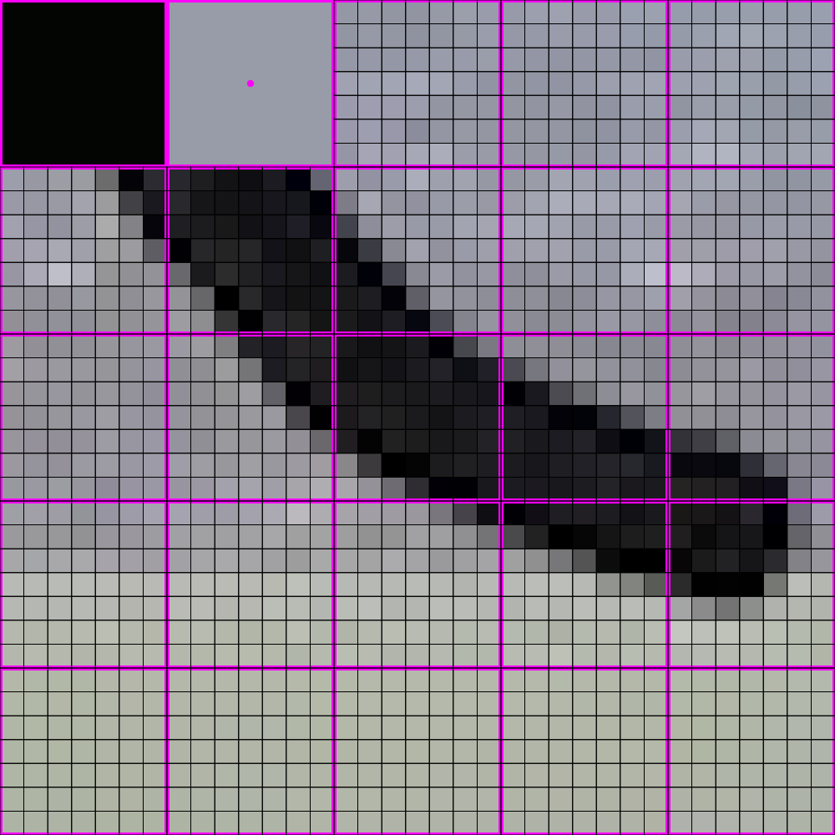
448x448 -> 64x64

Slide 73

448x448 -> 64x64

Slide 74
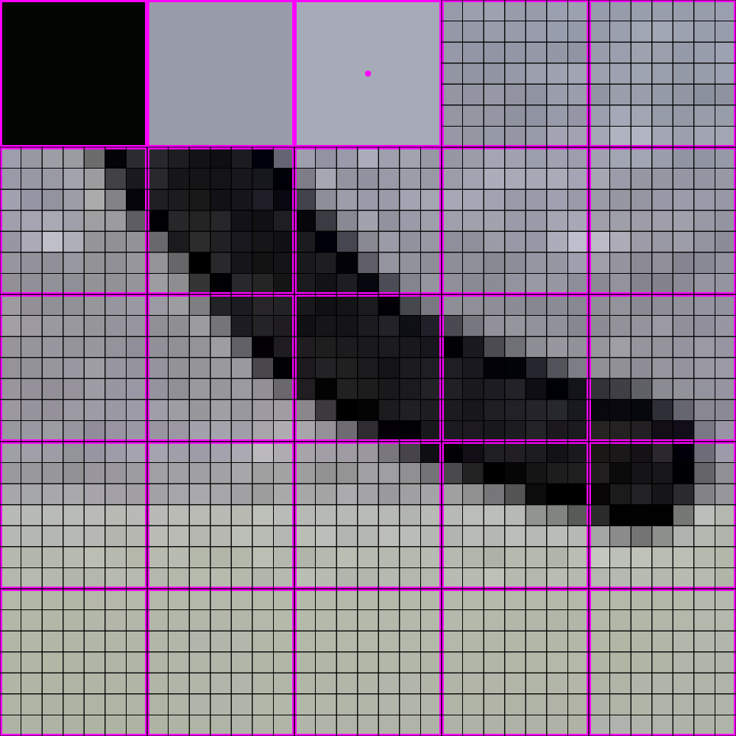
448x448 -> 64x64

Slide 75

448x448 -> 64x64

Slide 76
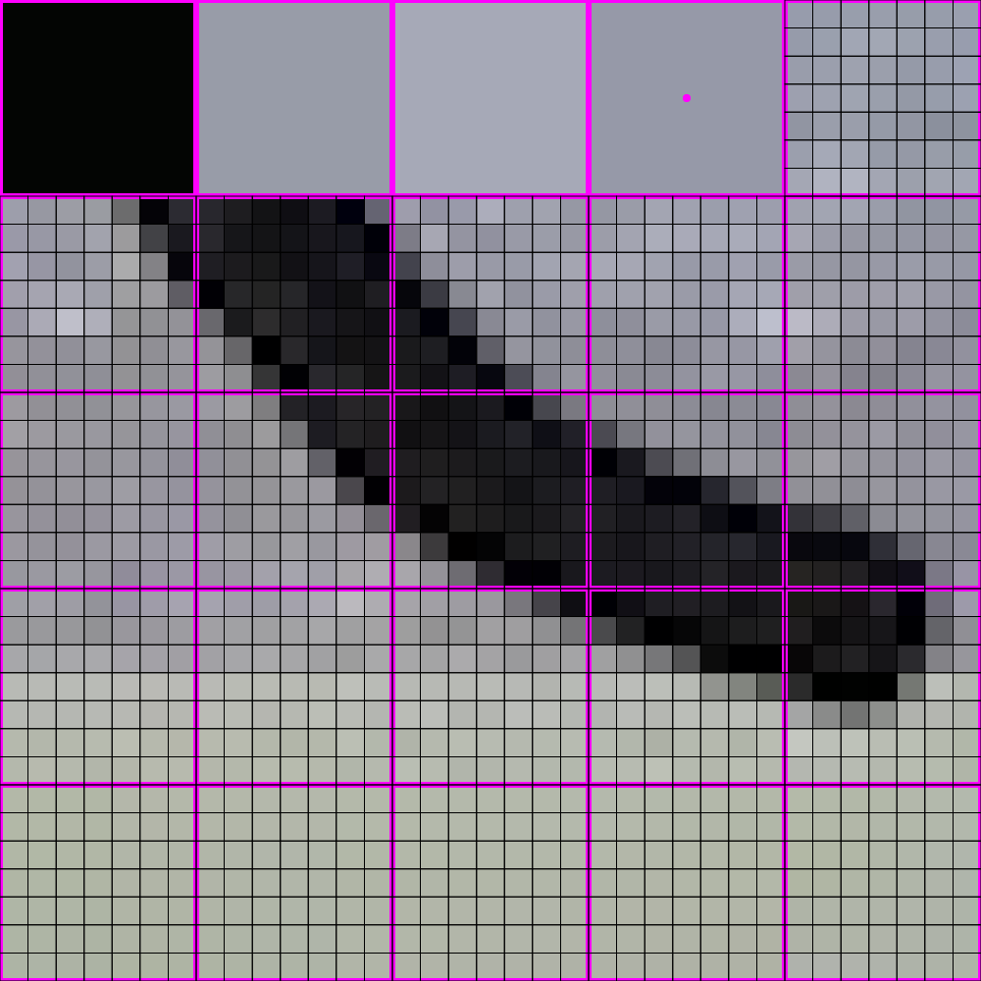
448x448 -> 64x64

Slide 77

448x448 -> 64x64

Slide 78
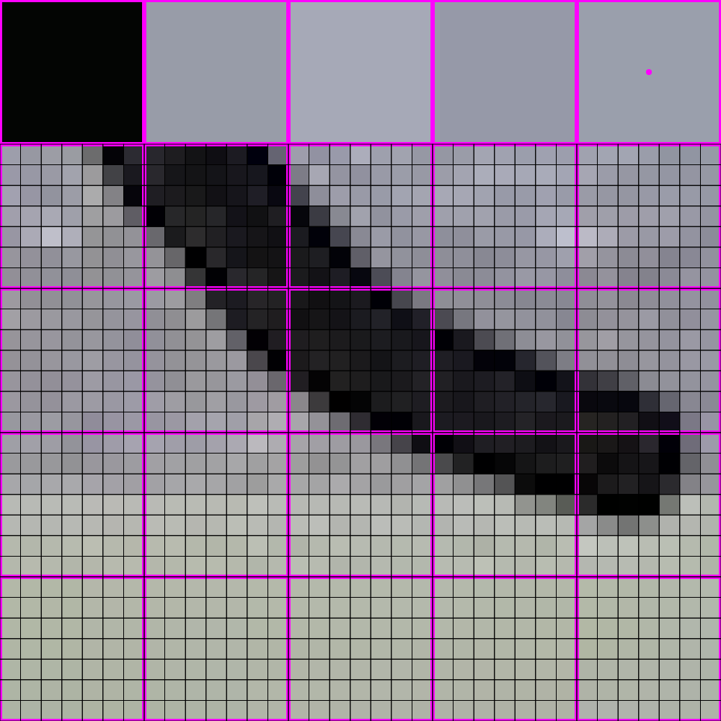
448x448 -> 64x64

Slide 79

448x448 -> 64x64

Slide 80
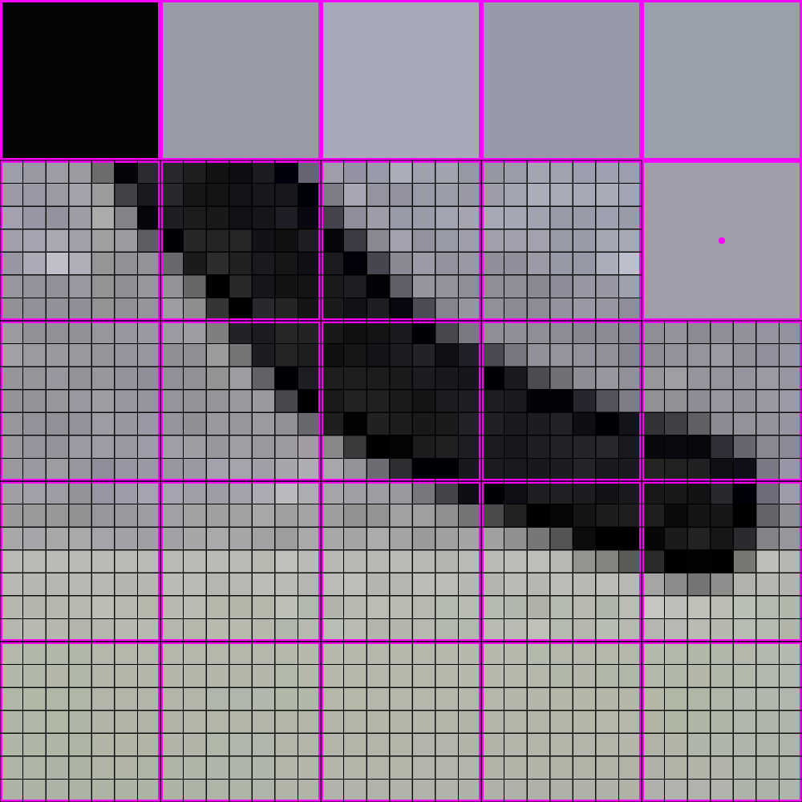
448x448 -> 64x64

Slide 81
448x448 -> 64x64

Slide 82

448x448 -> 64x64

Slide 83
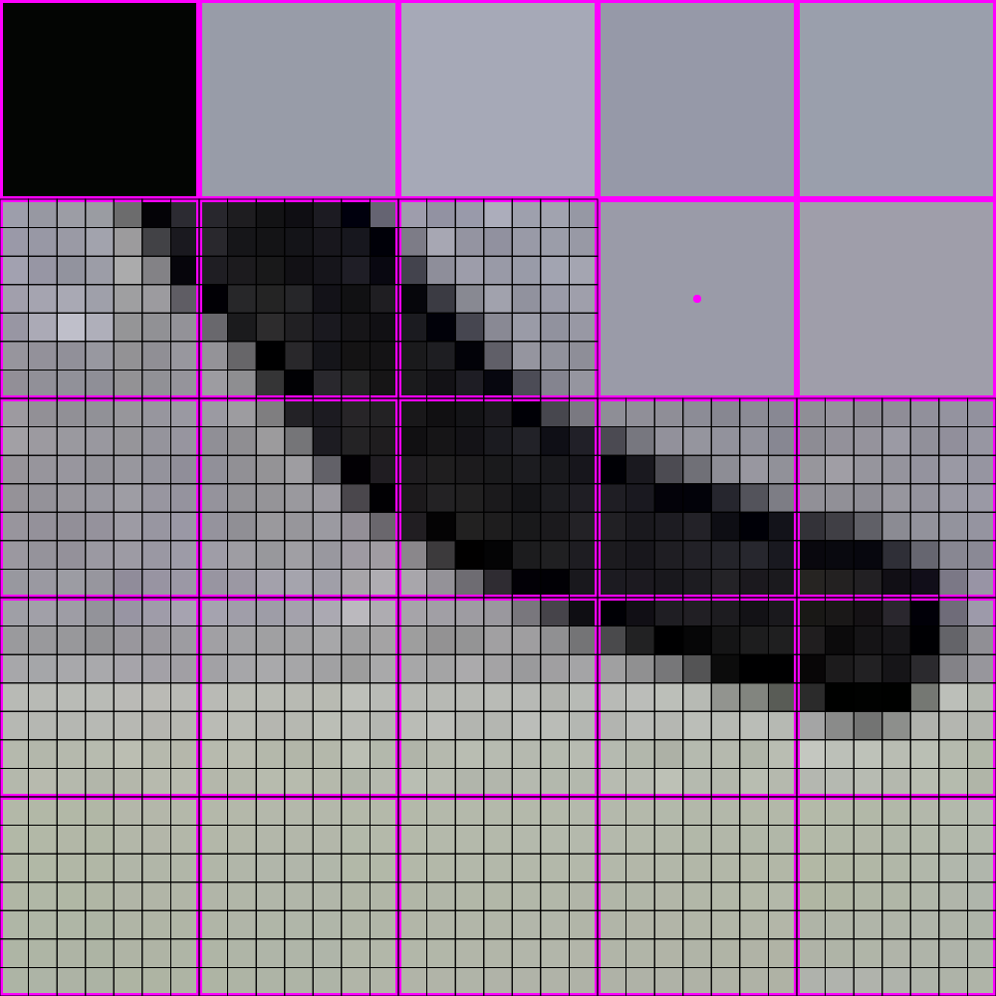
448x448 -> 64x64

Slide 84

448x448 -> 64x64

Slide 85
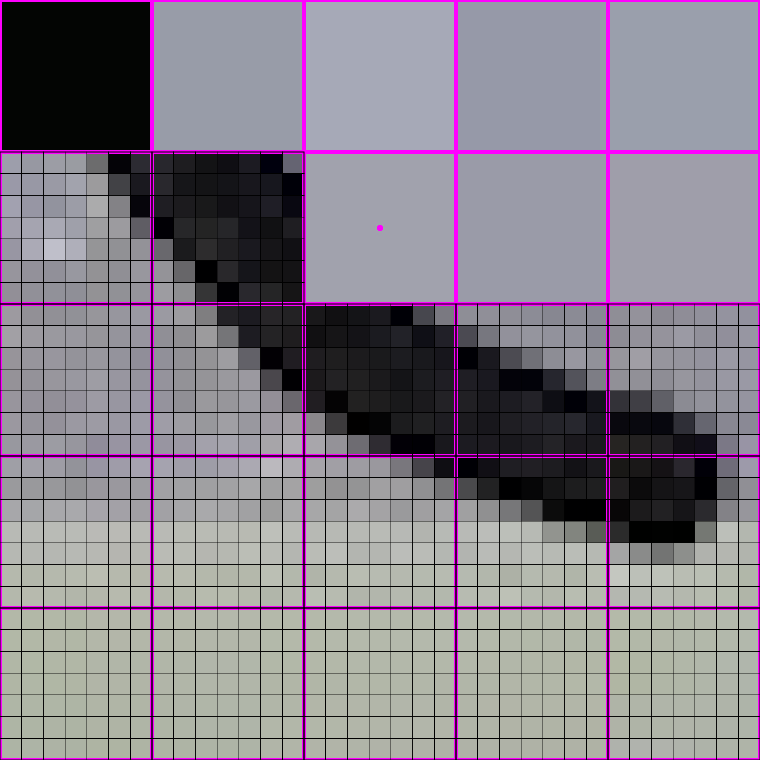
448x448 -> 64x64

Slide 86

448x448 -> 64x64

Slide 87

448x448 -> 64x64

Slide 88

448x448 -> 64x64

Slide 89

448x448 -> 64x64

Slide 90

448x448 -> 64x64

Slide 91

448x448 -> 64x64

Slide 92

448x448 -> 64x64

Slide 93

448x448 -> 64x64

Slide 94

448x448 -> 64x64

Slide 95

448x448 -> 64x64

Slide 96

448x448 -> 64x64

Slide 97

448x448 -> 64x64

Slide 98

448x448 -> 64x64

Slide 99

448x448 -> 64x64

Slide 100
448x448 -> 64x64

Slide 101

448x448 -> 64x64

Slide 102

448x448 -> 64x64

Slide 103
IS THIS ALL THERE IS??

Slide 104

THERE IS A BETTER WAY!

Slide 105

LOOK AT HOW MUCH BETTER

Slide 106
How do?

Slide 107

How do? Averaging!

Slide 108


How do? Averaging!
“interpolation”
averaging
X

Slide 109

What is averaging?

Slide 110

What is averaging? A weighted sum

Slide 111

What is averaging? A weighted sum

Slide 112

Call this operation “convolution”
Filter or kernel

Slide 113

Convolutions on larger images

Slide 114

Kernel slides across image

Slide 115

Convolutions on larger images

Slide 116

This is called box filter
Box filters

Slide 117
Box filters smooth image
Box filters

Slide 118
Box filters smooth image
Box filters

Slide 119
Now we resize our smoothed image

Slide 120
So much better!

Slide 121
Before/After

Slide 122


Box filters have artifacts

Slide 123
Box filters have artifacts

Slide 124
Box filters: vertical + horizontal streaking

Slide 125
Box filters: vertical + horizontal streaking

Slide 126
Box filters: vertical + horizontal streaking

Slide 127
Box filters: vertical + horizontal streaking

Slide 128
We want a smoothly weighted kernel

Slide 129


Gaussians

Slide 130


2d Gaussian

Slide 131

Better smoothing with Gaussians
=
*

Slide 132
Better smoothing with Gaussians

Slide 133
Better smoothing with Gaussians

Slide 134

Wow, so what was that convolution thing??

Slide 135

Wow, so what was that convolution thing??

Slide 136

Calculate it, go!

Slide 137

Calculate it, go!

Slide 138

Guess that kernel!

Slide 139

Highpass Kernel: finds edges

Slide 140

Guess that kernel!

Slide 141
Identity Kernel: Does nothing!

Slide 142

Guess that kernel!

Slide 143

Sharpen Kernel: sharpens!
Note: sharpen = highpass + identity!

Slide 144

Guess that kernel!

Slide 145

Emboss Kernel: stylin’

Slide 146


Guess those kernels!

Slide 147


Sobel Kernels: edges and…

Slide 148

Sobel Kernels: edges and gradient!

Slide 149
Sobel Kernels: edges and gradient!

Slide 150
And so much more!!

